Slide 1
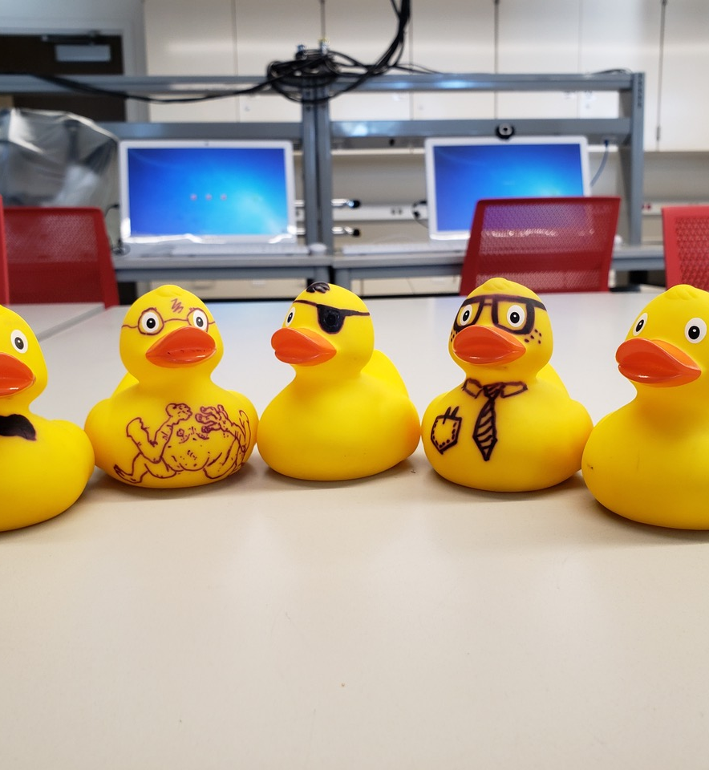


Exploring Mindset & Response to Failure in Reformed IPLS Labs
JORDAN GERTON | Jason May | Claudia De Grandi
  University of Utah
Lisa Corwin
  University of Colorado at Boulder
Shayla Shorter
  Emory University

Slide 2
Project Foundations
Proposition #1:
A student’s response to challenge & failure influences their success.
(e.g., Carol Dweck, The New Psychology of Success)
Proposition #2:
Authentic scientific inquiry/research
requires failure for progress.
Proposition #3:
Inquiry-driven teaching laboratories provide excellent opportunities for students to experience failure and
develop coping strategies.

Slide 3
Project Components
FLAMEnet
(Heemstra/Corwin/Charkoudian)
UMD NEXUS Labs
(Moore et al., AJP, 2014)
U of Utah
IPLS Lab Reform

Slide 4
Failure as a part of Learning,
A Mindset Education network
NSF RCN UBE (incubator): 1827160
NSF RCN UBE (5-years): 2019-2024
You can join!
Shayla Shorter, Pam Harvey, Jordan Gerton, Lisa Corwin, Joe Harsh, Lou Charcoudian, Meredith Henry, Lisa Limeri, Ben Li, Mary Beth Anzovino, Omar Villanueva, Jen Heemstra, Megan Cole
Notes:
Future directions
Active group of researchers in Chemistry, Physics, Biology, Education, Psychology working on how to address failure in research-based courses
Mention some of this work – Review recently published, FLAMEnet recently funded… whatever you think is appropriate.

Slide 5
IPLS Labs @ Utah (adapted from NEXUS)
Jason May
Brianna Montoya (now @ UMD)
Claudia De Grandi
Isaac Brown
Lab 0:
norm/group setting
Lab 1:
Zebrafish motion in 2D
Lab 2:
Drag and terminal vel
Lab 3:
Diffusion on a flat surface
Lab 4:
Diffusion + directed motion
Lab 5:
Active transport of vesicles
1 week
2 weeks
2 weeks
3 weeks
2 weeks
2 weeks
>70% med school aspirants
~90-220 students per semester
Sections of 24: 1 GTA + 1 LA per section

Slide 6
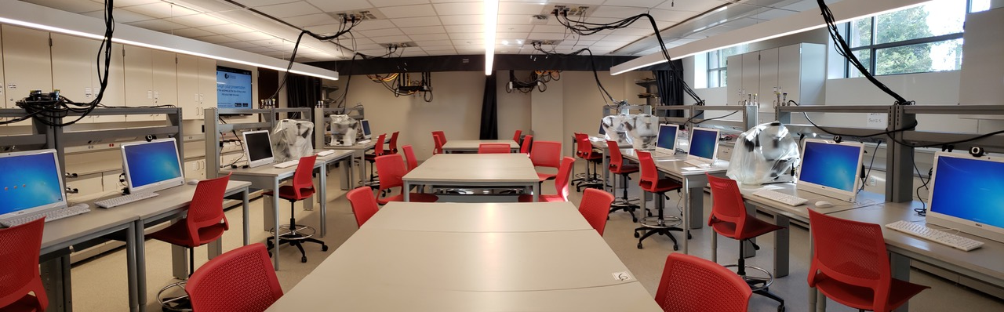
IPLS Labs @ Utah (adapted from NEXUS)
Jason May
Brianna Montoya (now @ UMD)
Claudia De Grandi
Isaac Brown
Lab 0:
norm/group setting
Lab 1:
Zebrafish motion in 2D
Lab 2:
Drag and terminal vel
Lab 3:
Diffusion on a flat surface
Lab 4:
Diffusion + directed motion
Lab 5:
Active transport of vesicles
1 week
2 weeks
2 weeks
3 weeks
2 weeks
2 weeks
Teams of 3 to 4

Slide 7
IPLS Labs @ Utah (adapted from NEXUS)
Jason May
Brianna Montoya (now @ UMD)
Claudia De Grandi
Isaac Brown
Lab 0:
norm/group setting
Lab 1:
Zebrafish motion in 2D
Lab 2:
Drag and terminal vel
Lab 3:
Diffusion on a flat surface
Lab 4:
Diffusion + directed motion
Lab 5:
Active transport of vesicles
1 week
2 weeks
2 weeks
3 weeks
2 weeks
2 weeks
Inter-team dialog

Slide 8
FLAMEnet intervention timeline
FLAMEnet
Writing Prompt #1
FLAMEnet
Writing Prompt #3
Lab 0:
norm/group setting
Lab 1:
Zebrafish motion in 2D
Lab 2:
Drag and terminal vel
Lab 3:
Diffusion on horizontal surface
Lab 4:
Diffusion + directed motion
Lab 5:
Active transport of vesicles
1 week
2 weeks
2 weeks
3 weeks
2 weeks
2 weeks
FLAMEnet
Writing Prompt #2
FLAMEnet
Final Written Synth

Slide 9
FLAMEnet intervention timeline
FLAMEnet
Writing Prompt #1
7 weeks
FLAMEnet
Writing Prompt #3
Lab 0:
norm/group setting
Lab 1:
Zebrafish motion in 2D
Lab 2:
Drag and terminal vel
Lab 3:
Diffusion on horizontal surface
Lab 4:
Diffusion + directed motion
Lab 5:
Active transport of vesicles
1 week
2 weeks
2 weeks
3 weeks
2 weeks
2 weeks
FLAMEnet
Writing Prompt #2
FLAMEnet
Final Written Synth

Slide 10
FLAMEnet intervention
WRITTEN PROMPTS 1 & 3
Q1: Describe research-related challenges, failures and/or unanticipated results that you encountered during the lab.
Q2: Describe the thoughts & feelings you experienced in response to these challenges.
Q3: Describe actions you took after encountering the challenge. Were these actions helpful or unhelpful? Why?

Slide 11
FLAMEnet intervention
WRITTEN PROMPTS 1 & 3
WRITTEN PROMPT 2
Q1: Describe research-related challenges, failures and/or unanticipated results that you encountered during the lab.
Q1: Describe a potential research-related challenge that may occur in the upcoming two weeks (Lab 4).
Q2: Describe the thoughts & feelings you experienced in response to these challenges.
Q2: Describe the actions you might take in response to this challenge. What is your rationale for taking these potential actions?
Q3: Describe actions you took after encountering the challenge. Were these actions helpful or unhelpful? Why?
Examine coping mechanisms expressed in
student responses to Q3 for written prompts #1 and #3
Q4: How did preparing for anticipated challenges change your thoughts, emotions, or behaviors when responding to this new challenge?

Slide 12
FLAMEnet intervention
WRITTEN PROMPTS 1 & 3
WRITTEN PROMPT 2
Q1: Describe research-related challenges, failures and/or unanticipated results that you encountered during the lab.
Q1: Describe potential research-related challenges that may occur in the upcoming two weeks (Lab 4).
Q2: Describe the thoughts & feelings you experienced in response to these challenges.
Q2: Describe actions you might take in response to this challenge. What is your rationale for taking these potential actions?
Q3: Describe actions you took after encountering the challenge. Were these actions helpful or unhelpful? Why?

Slide 13
FLAMEnet intervention
WRITTEN PROMPTS 1 & 3
WRITTEN PROMPT 2
Q1: Describe research-related challenges, failures and/or unanticipated results that you encountered during the lab.
Q1: Describe potential research-related challenges that may occur in the upcoming two weeks (Lab 4).
Q2: Describe the thoughts & feelings you experienced in response to these challenges.
Q2: Describe actions you might take in response to this challenge. What is your rationale for taking these potential actions?
Q3: Describe actions you took after encountering the challenge. Were these actions helpful or unhelpful? Why?
Q4: How did preparing for anticipated challenges change your thoughts, emotions, or behaviors when responding to this new challenge?

Slide 14
Sample student responses
WRITTEN PROMPT #1
WRITTEN PROMPT #3
After encountering these problems I asked many questions to fellow students in the lab and the TA's who were able to offer some clarification and other students calmed my frustrations by showing me that they were experiencing some of the same issues.
I performed extra work to analyze the data and make sure that we would be able to retrieve our uncertainty value and Beta value. Myself and one other team member worked very hard to correct what went wrong & re-perform the experiment.
Whenever I couldn't figure out something, I quickly was asking questions of someone and had them stay with me till I figured out the solution. As far as lack of time, I just had to be patient and do the best I could, because I realized that others’ understanding was more important than coming up with the final product.
When leveling our microscope, we used several tools and measured how level it was from several spots. We used anything that was sturdy enough to withstand the microscope’s weight to alter it as necessary. We thought, discussed, and put the ideas into action.

Slide 15
Codebook Development / Categories
Outcomes
(34 codes
IRR = 0.79)
Coping Strategies
(18 codes
IRR = 0.85)
Emotions
(23 codes
IRR = 0.89)
Failures/Challenges
(12 codes
IRR = 0.87)
Codebook developed by: Lisa Corwin (UC Boulder) and Joe Harsh (James Madison)
They types of challenges/failures students experienced and reported.
The emotions they experienced as a result of the challenge/ failure.
How they consciously responded to the challenge or failure.
The effect of employing the coping strategy
Coping codes: Skinner, Altman, & Sherwood, 2003
Outcomes codes: Corwin, Graham, & Dolan, 2015

Slide 16
Codebook Development / Categories
Outcomes
(34 codes
IRR = 0.79)
Coping Strategies
(18 codes
IRR = 0.85)
Emotions
(23 codes
IRR = 0.89)
Failures/Challenges
(12 codes
IRR = 0.87)
Codebook developed by: Lisa Corwin (UC Boulder) and Joe Harsh (James Madison)
They types of challenges/failures students experienced and reported.
The emotions they experienced as a result of the challenge/ failure.
How they consciously responded to the challenge or failure.
The effect of employing the coping strategy
Coping codes: Skinner, Altman, & Sherwood, 2003
Outcomes codes: Corwin, Graham, & Dolan, 2015

Slide 17
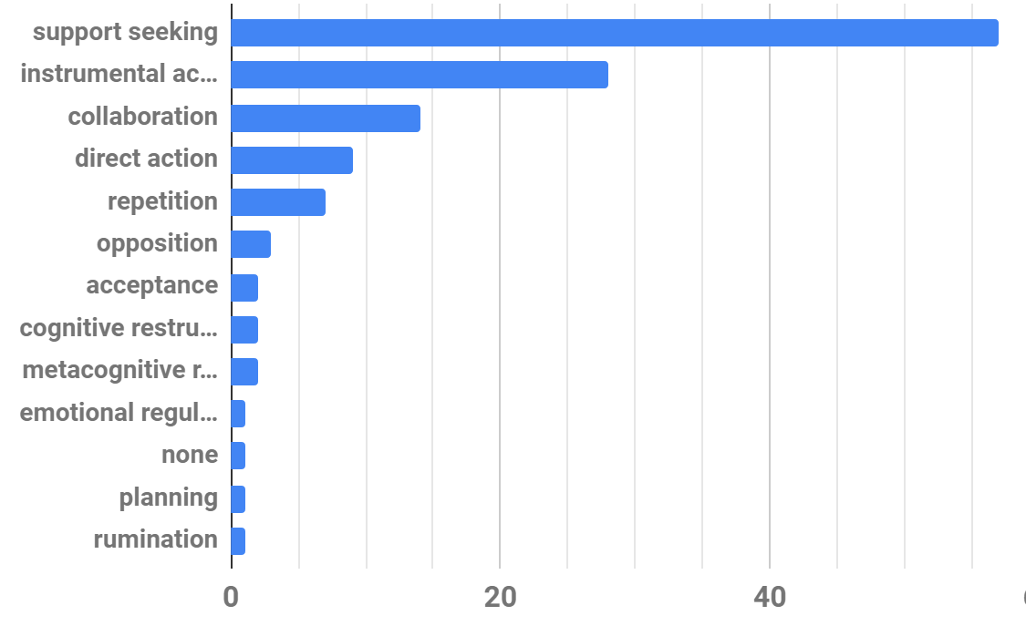
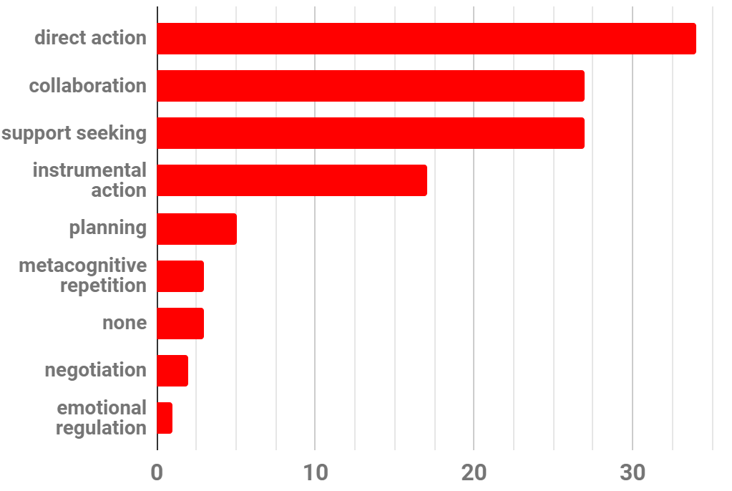
Preliminary data
WRITTEN PROMPT #1
WRITTEN PROMPT #3
N_{codes} = 128
N_{resp} = 82
N_{codes} = 119
N_{resp} = 81

Slide 18
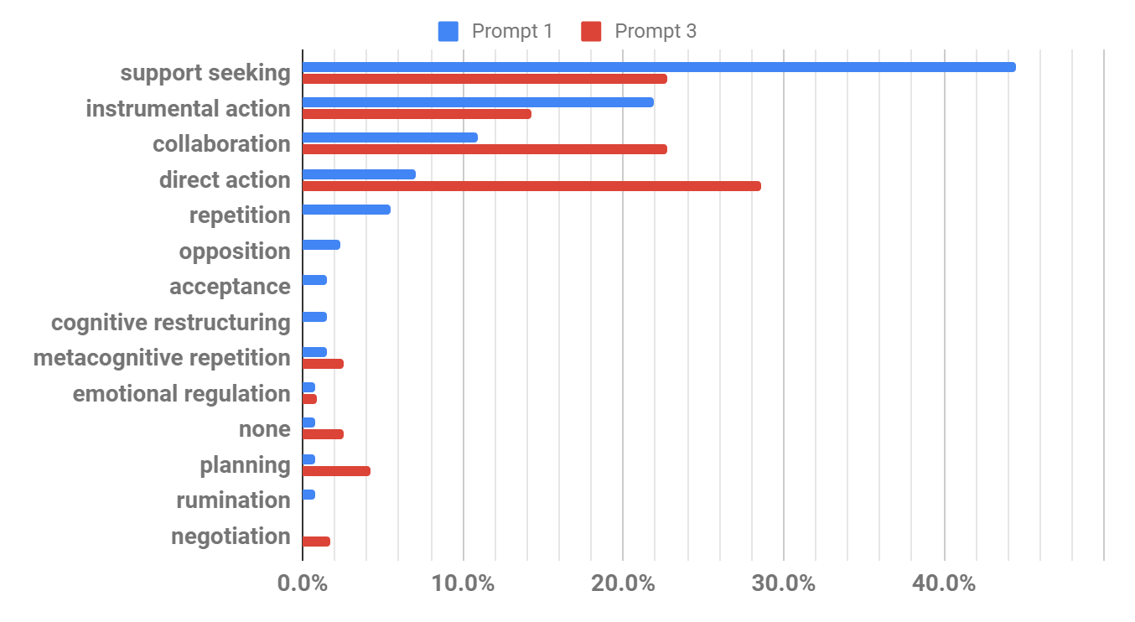
Preliminary data
Prompt 1: N_{codes} = 128
Prompt 3: N_{codes} = 119

Slide 19
A couple reflections
I have found the FLAMEnet student reflections to provide excellent insight into student struggles
  Useful in weekly instructional team meetings
  Helps me feel connected to the class
I provide individualized feedback to each student through the FLAMEnet interventions
  Help them interpret struggle and frustration more productively
  Interesting potential area for future research

Slide 20
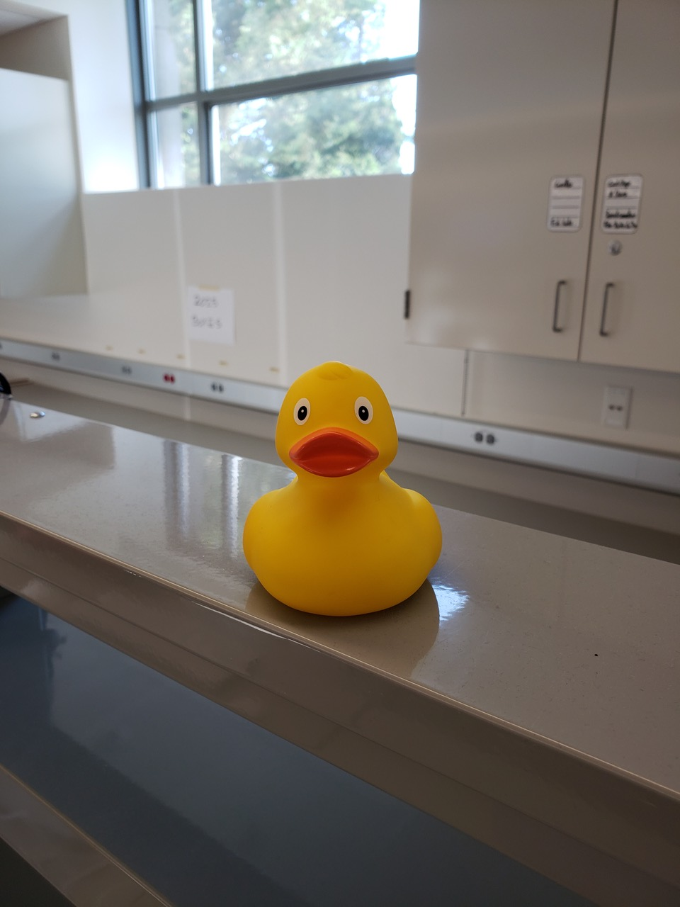
Future work
Recruit additional coders:
  adapt codebook and IRR
Code for other dimensions:
  investigate variation in challenges and emotions
Disaggregate data:
  compare different sub-populations
Establish a control/comparison group:
  are changes due to FLAMEnet intervention or natural progression within course?
Investigate instructor feedback to student responses

Slide 21

Acknowledgments
Jason May: PER Graduate Student @ Utah
Brianna Montoya: PER Graduate Student @ UMD (formerly Utah)
Claudia De Grandi: Physics & Astronomy Faculty @ Utah
Lisa Corwin: Biology Education Faculty @ UC Boulder
Shayla Shorter: Science Education Postdoc @ Emory
Jen Heemstra: Chemistry Faculty @ Emory
Lauren Barth-Cohen: Educational Psychology Faculty @ Utah
NSF RCN UBE (incubator): 1827160
NSF RCN UBE (5-years): 2019-2024

