Slide 1
A Tale of Two Classrooms:
Creating and Assessing Classroom Interventions to Improve College-Level STEM Students’ Approaches and Reactions to Challenges and Failure
Meredith A. Henry, Shayla Shorter,
Louise Charkoudian, Jennifer M. Heemstra, and Lisa A. Corwin
Gordon Research Seminar – Undergraduate Biology Education Research
June 22, 2019

Slide 2
Intro
Navigating scientific challenges, persevering through difficulties, and coping with failure are considered hallmarks of a successful scientist. _{(Andrews & Lemons, 2015)}
However, many students into college STEM courses ill-equipped to “embrace failure” (Bennett, 2017; Simpson and Maltese, 2017
This can lead to lack of engagement, underachievement, burnout, and attrition _{(Henry et al., 2019)}
Need: Ways instructors can explicitly guide students to develop a challenge-engaging mindset
Problem: Few studies investigate how undergraduate STEM students develop these skills how STEM instructors can facilitate this development
Solution: FLAMEnet

Slide 3
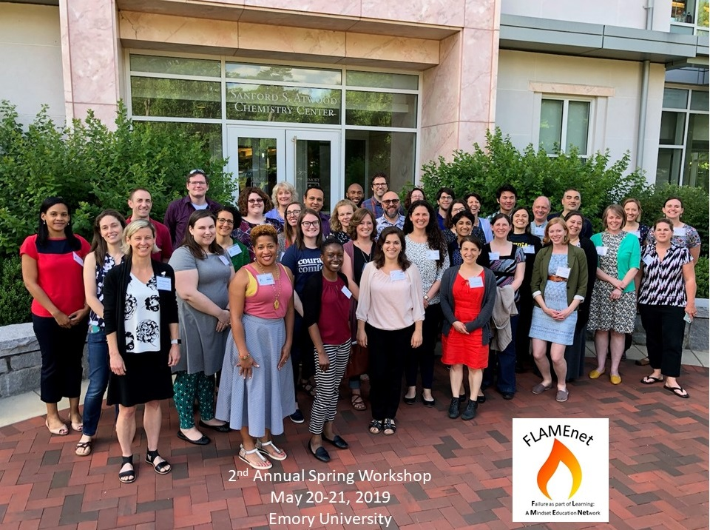
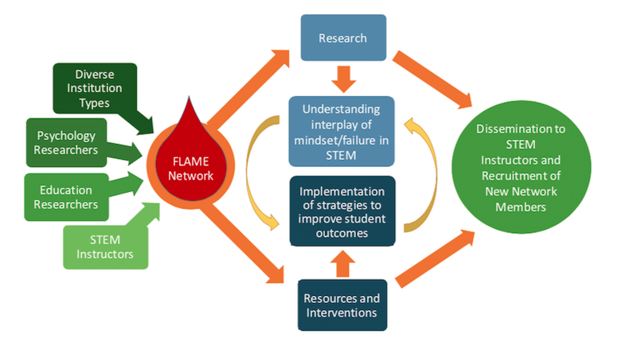

What is FLAMEnet?
Goal: Cultivate the next generation of resilient, risk-taking STEM innovators developing and utilizing interventions built upon frameworks of:
  Fear of failure
  Mindset
  Goal orientation
  Coping
Failure as a Part of Learning: A Mindset Education Network
@FailureMindset https://flamenet.qubeshub.org
Notes:
NSF funded research coordination network founded in 2017.
Current membership:
≈ 40 individuals from ≈ 20 different institutions
75% female, 25 % male
20% non-White, 80% White
“Diversity by design”
35% PUI
35% R1
12 % Community College
9% Comprehensive
8% Minority-serving
6% Hispanic-serving
4% HBC
4% Comprehensive

Slide 4
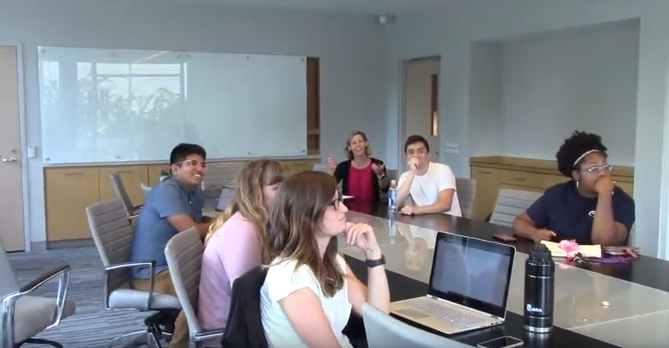
Reflections on Learning (Lab)
Failure is just part of our job here, and working hard through your failure is how we succeed and make more discoveries….
Everyone! Everyone! Look at Pam! Look at what she’s done! Isn’t this just so great? Can’t all of you just be more. like. Pam?
Intro & Pre-Survey
Within first 3 weeks of class
*Written Prompt 1
*Written Prompt 2
Before the students’ second research assignment
*Written Prompt 3
After the completion of the students’ second research assignment
*Written Prompt 4
*Final Project
At the end of the semester.
After first collection of data/results in lab.
Post Survey
Use provided Qualtrics link
Use provided Qualtrics link
During last few weeks of class
Notes:
Emphasize the prompts occur at times when failure/challenge is expected.

Slide 5
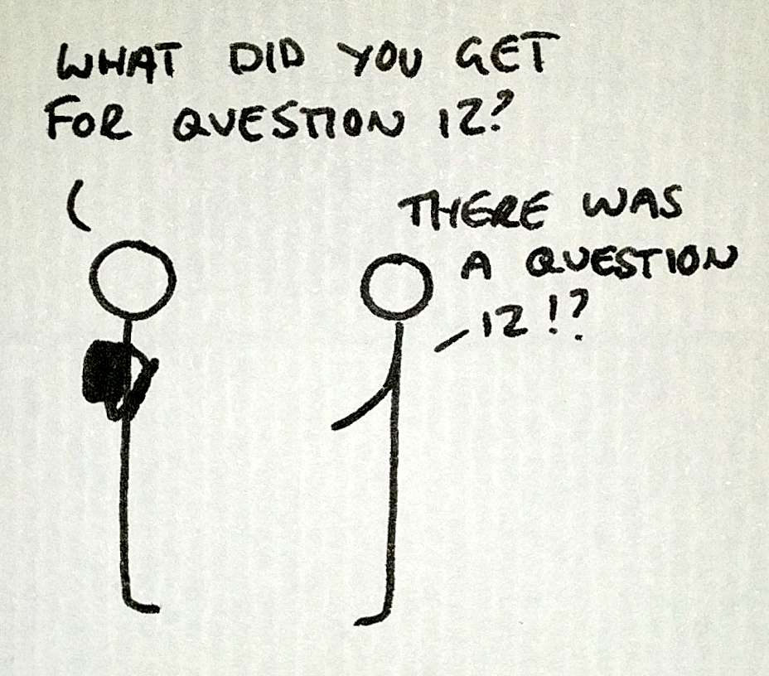
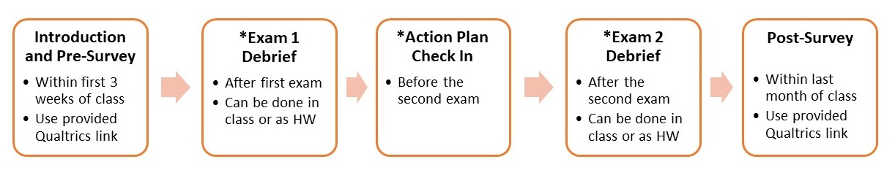
Exam Debrief (Lecture)
…
3. Identify a question that you got incorrect or did not receive full credit for.
● If you did not get any incorrect answers, pick the most challenging question
You got correct or received full credit for and answer the question below:
Question # __________
4. Write the correct answer below with an explanation for why it is the correct answer.
5. Reflect on why you may have missed this question or why it was particularly challenging.
What actions could you have taken that would have helped you to learn this material or better
approach the question, and thus answer it correctly on the exam?
…
Notes:
Add sample of debrief

Slide 6
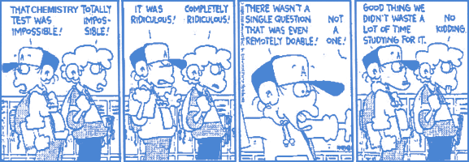
Fear of Failure (FF)
Emotional and/or cognitive response to a perceived threat (failure) that affects behavior. _{(Cacciotti, 2015)}
High FF leads to negative academic outcomes, most often through low challenge engagement and self-handicapping. (Bledsoe & Baskin, 2014; Elliot & Thrash, 2004)

Slide 7
Measuring FF
Performance Failure Appraisal Inventory (PFAI) _{(Conroy, 2002)}
  Scale: 5 point from 1 “Never true of me” to 5 “True of me all of the time.”
  Re-validated, STEM undergrads, n=1309: Confirmed 4 reasons STEM undergraduates fear failure:
Subscale | Sample Item
Fear of an Uncertain Future (FUF) | “When I am failing…it upsets my “plan” for the future.”
Fear of Important Others Losing Interest (FIOLI) | “When I am not succeeding…my value decreases for some people.”
Fear of Upsetting Important Others (FUIO) | “When I am failing…important others are disappointed.”
Fear of Experiencing Shame and/or Embarrassment (FSE) | “When I am failing…I worry about what others think about me.”
Notes:
STEM specific revalidation

Slide 8
Our Two Classes
Fall 2018
Lab course
  Multiple sections of Foundations of Biology lab
  Public research university in mid-Atlantic U.S.
  N=575; 70% female
Lecture course
  Two sections of Introductory Chemistry
  Public research university in southeast U.S.
  N=121; 78% female

Slide 9



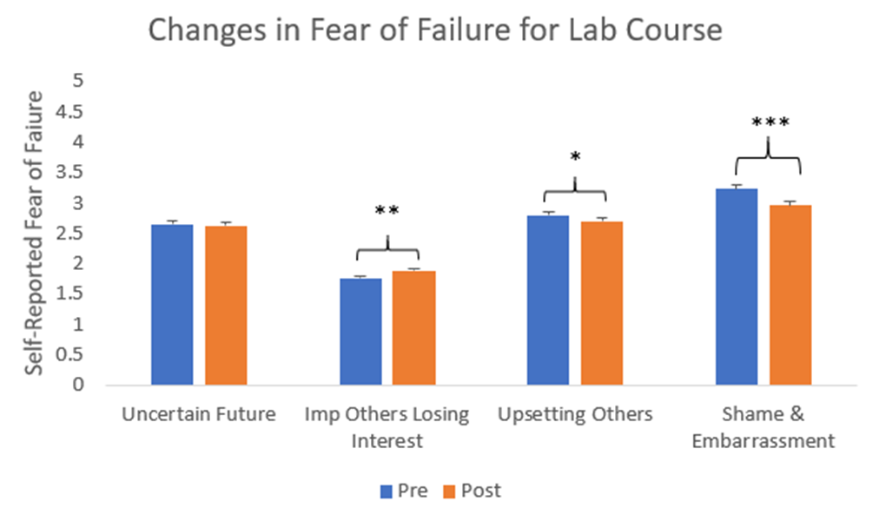
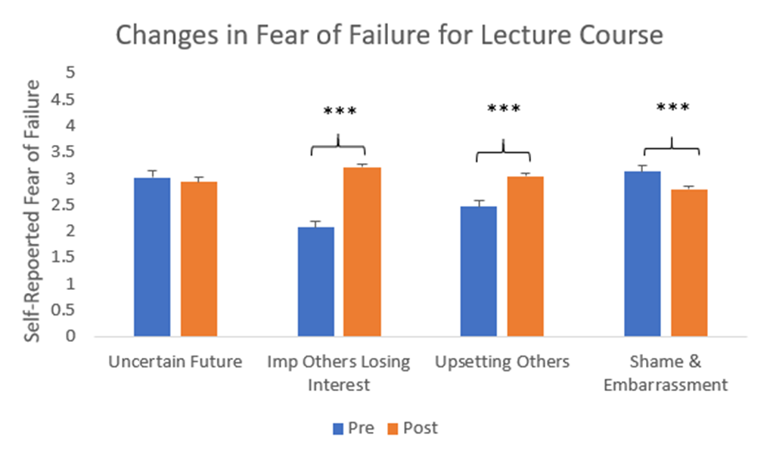
Overall Changes in FF
Lab Course
Lecture Course

Slide 10
Exploring Interactions in Fear of Failure
Looking at data across all our classrooms (12 in Fall 2018) makes things a lot muddier
Many factors could be moderating the effects of interventions on fear of failure
    Further analysis: Multiple linear regression
      Dependent Variable: Change Score for Fear of Failure subscales
      (Pre-survey score – Post survey score)
      Predictor Variables:
        Round One: Baseline Fear of Failure, Gender, SES, Race (Caucasian or non-Caucasian), Ethnicity (Hispanic/Latinx or non-Hispanic/Latinx, Prior College STEM experience, STEM anxiety
        Round Two: Baseline Fear of Failure, Ethnicity, STEM experience, STEM anxiety, Ethnicity*Experience, Ethnicity*Anxiety
Notes:
Should I break out regression formula more visually?

Slide 11
Exploring Interactions in Fear of Failure
Surprising, no significant main effects for gender, class standing, or SES for either lab or lecture class
Did find some effects for race, ethnicity, STEM experience, and STEM anxiety.
Decided to test the interactions of these predictors
Found some interesting results and, more importantly, where significant interactions were found, the main effects were no longer significant.

Slide 12
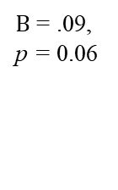
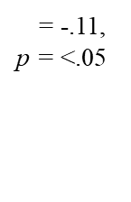
Exploring Interactions in Fear of Failure
FIOLI = Fear of Losing Others’ Interest
Prior experience with STEM courses did not influence the effect of the lab intervention for non-Hispanic students.
Hispanic students with low/no STEM experience reported less increase in FIOLI.
Hispanic students with STEM experience reported FIOLI levels similar to non-Hispanic students.
Low STEM Experience
High STEM Experience
$Β$ = .09, p = 0.06
$Β$ = -.11, p = <.05

Slide 13
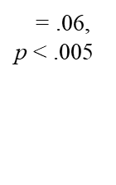
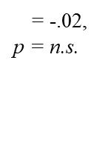
Ethnicity interacts with STEM anxiety
FUF = Fear of Uncertain Future
Hispanic students who had a lot of STEM anxiety reported less increase in FUF across the semester.
$Β$ = .06, p < .005
$Β$ = -.02, p = n.s.

Slide 14
Discussion
Overall, both interventions were successful in lowering some aspects of students’ fear of failure
One consistent result in these two courses was a decrease in fear of shame and embarrassment
  Since both interventions explicitly talk through failure, it may provide “exposure therapy”
  Having the intervention experience with peers may alleviate “self-conscious” aspects of embarrassment and shame
  Interventions may target internal processes more relevant to FSE
Most areas of fear of failure increased on average.
  Pre-course evaluations may not be best measure of baseline
Notes:
Don’t cover developmental changes; will assess next year

Slide 15
Discussion
FIOLI = Fear of Important Others Losing Interest
FUF = Fear of Uncertain Future
STEM experience and STEM anxiety both interacted with Hispanic/Latinx self-identity and were related to the lowest increases in FF.
This suggests these interventions may be especially effective for students who fall into multiple categories of “at risk”.
One surprising finding: Hispanic students with more STEM experience show more FIOLI.
  These students may gain experience by seriously pursuing a STEM career →
    STEM success as important part of identity
    More important others who value STEM and STEM success

Slide 16
Limitations & Future Directions
This study investigates only two of our implementing classrooms, as well as only some of the factors that could have influenced the effects of interventions
Results suggest there may be issues with our existing assessment schedule.
Data are self-report and have limit in variance for some variables
These data show initial support for the effectiveness of FLAMEnet interventions to improve STEM undergraduates’ fear of failure, especially among students identifying with multiple risk categories.
Future study will continue this line of research with factors unique to our intervention design (e.g., timing of intervention, paper or online assessment, etc.)

Slide 17


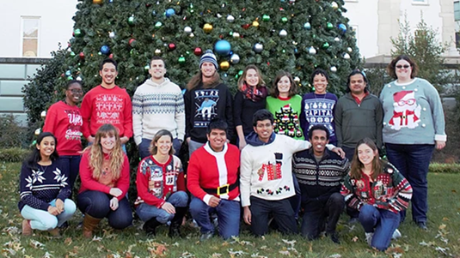
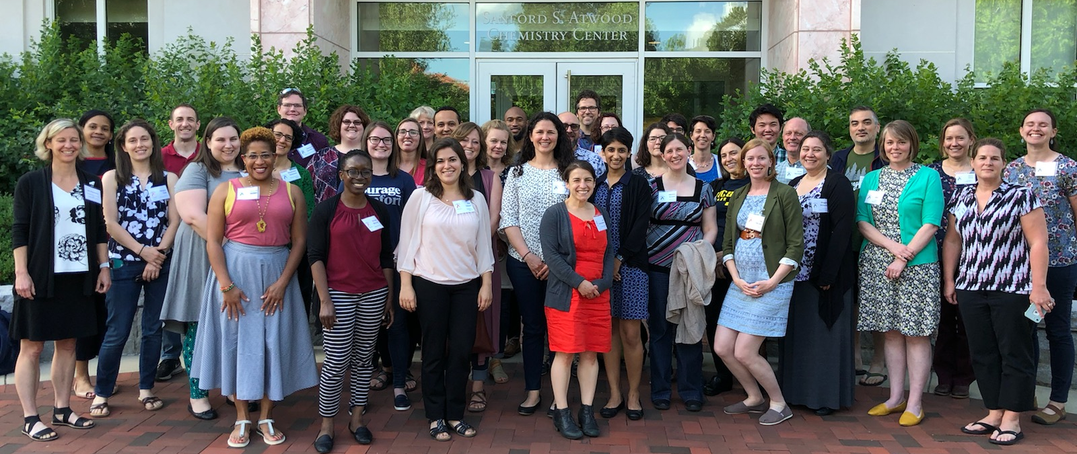




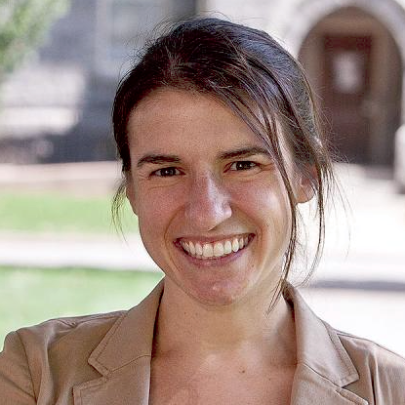




Acknowledgements
Our Instructors:
FLAMEnet Steering Committee:
Tracy McGill;
Emory University
Joe Harsh;
James Madison University
Jen Heemstra;
Emory University
Shayla Shorter;
Emory University
Lou Charkoudian;
Haverford College
Lisa Corwin;
CU Boulder
Award number: 1827160
Title: RCN UBE Incubator: Failure as a part of Learning, A Mindset Education Network (FLAMEnet)

Slide 18


Questions?

